Slide 1
PROJECT WORK ON EMBEEDED SYSTEMS WITH IOT
GROUP MEMBERS:
V.Charitha
K.Dharani
G.Tharaka Ramudu
G.Hemanth

Slide 2
IOT SMART HOME ,MONITORING AND CONTROLLING USING WEB PAGE
1.STREET LIGHTS AUTOMATION USING IR SENSORS
2.CONTROLLING SPEED OF FAN USING LDR
3.DOOR LOCKING USING WEB PAGE

Slide 3
STREET LIGHTS AUTOMATION
Components used:
IR Sensor
Connecting wires
Atmega 32 Development board
Basic shield

Slide 4
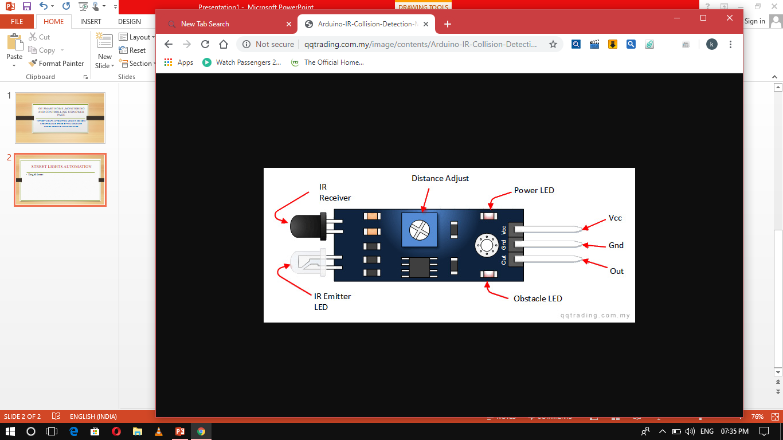
IR Sensor
An infrared sensor is an electronic device, that emits in order to sense some aspects of the surroundings.
An IR sensor can measure the heat of an object as well as detects the motion

Slide 5
APPLICATIONS:
Remote controlling functions
Smart phones to find distance of objects
Radiation thermometers
Human body detection
Gas analyzers
Rail safety
Night vision devices etc…..

Slide 6
BLOCK DIAGRAM OF AUTOMATIC STREET LIGHTS
Atmega32
Microcontroller
IR Sensor
LED Lights
output

Slide 7
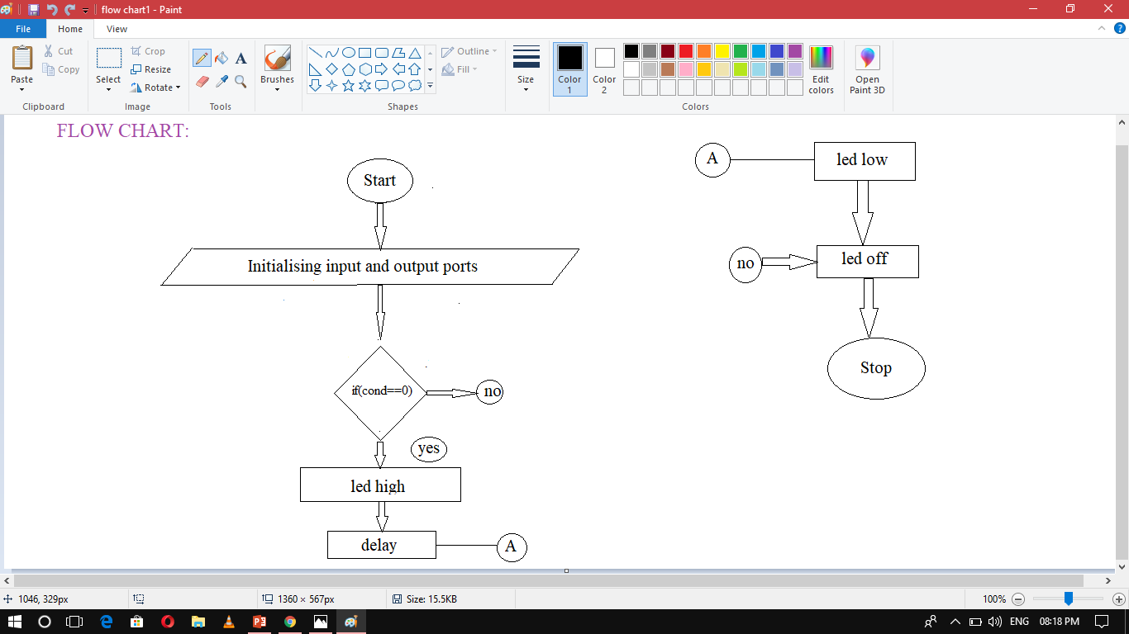

Slide 8
Algorithm:
1.Start the program.
2.Initialize the input and output ports.
3.Set a switch condition ,if the condition is true then on the led and delay for 500 milli seconds and off the led.
4.Else off the led.
5. Repeat it for several ports which were included.
6.Stop the program.

Slide 9
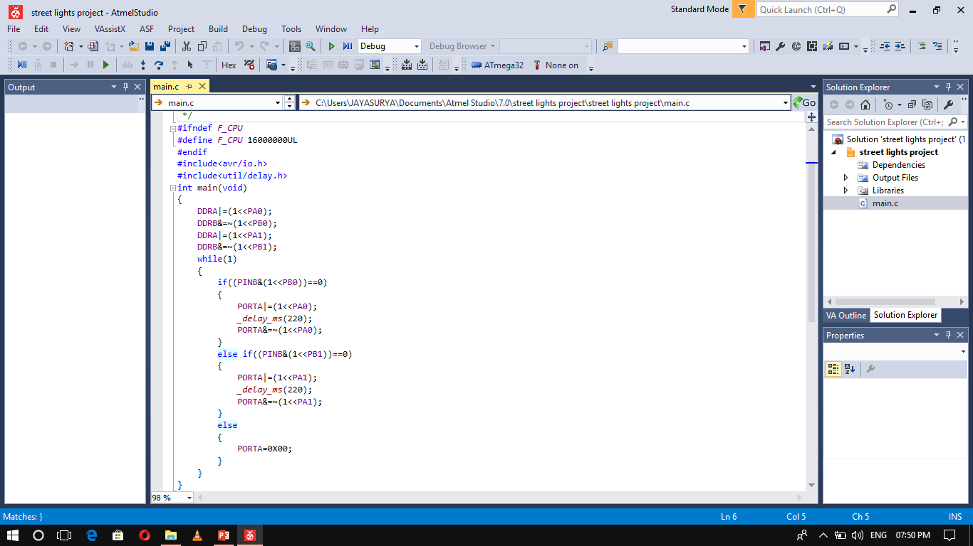

Slide 10
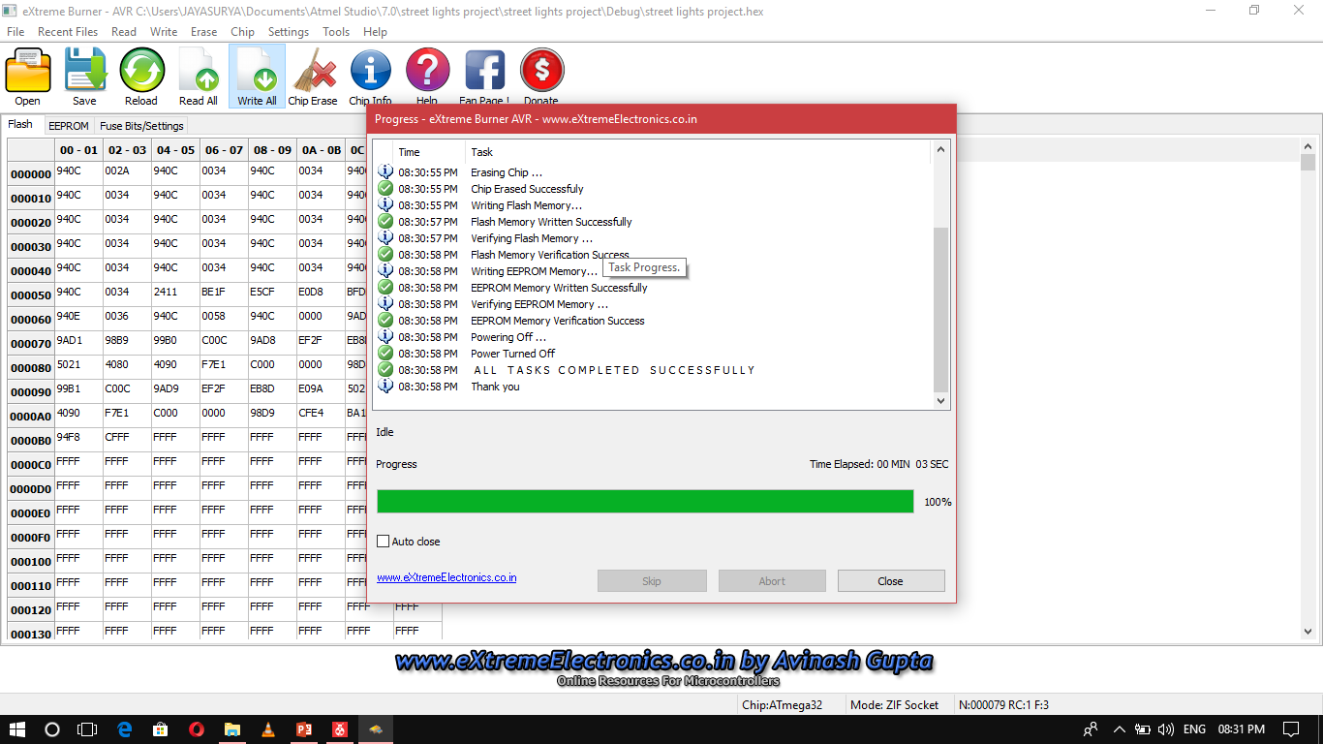

Slide 11
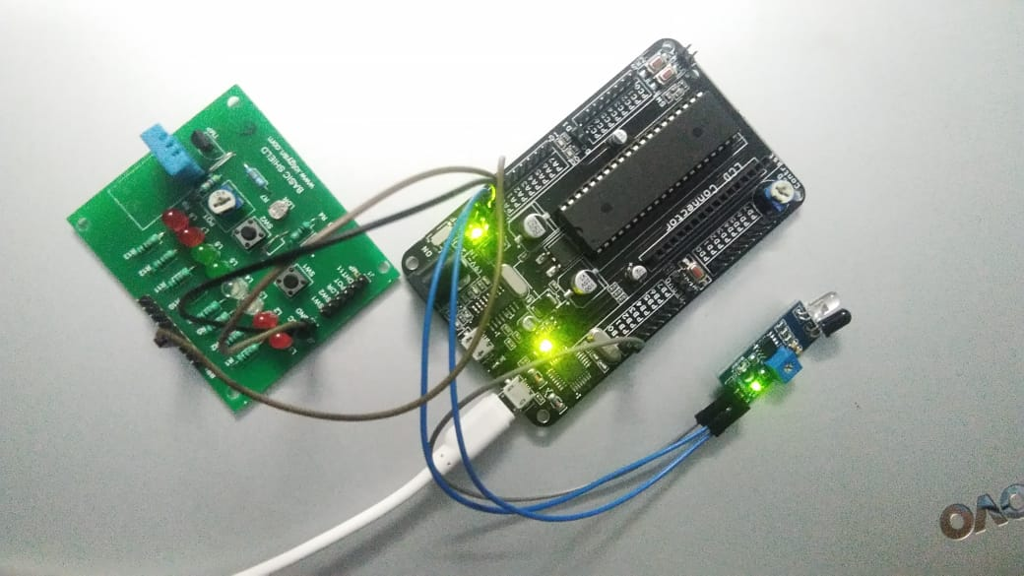
Working before the object passing through IR Sensor
Connections are set as per the picture shown.
IR Sensor has transmitter and receiver , transmitter is used to emit radiation of required wave length.
This radiation reaches the object and is reflected back , the reflected radiation is detected by the IR receiver.
The IR Receiver detected radiation is then further processed based on its intensity.

Slide 12
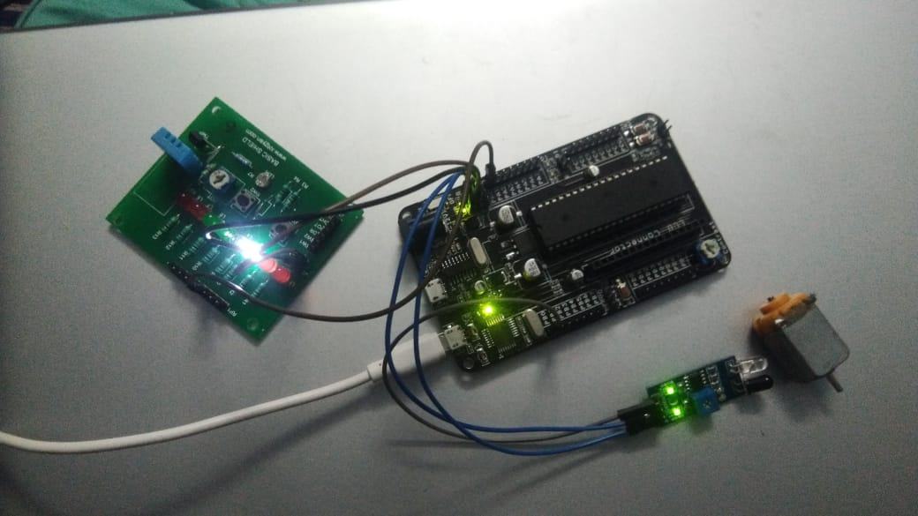
Working after the object passing through IR Sensor
When an object passes through IR Sensor , it results to turn “ON” led when an object goes away then led results to turn “OFF”.
When an object is placed is placed infront if IR Sensor it automatically receives the signal and transmitter emits the signal and makes led to turn “ON”
When an object goes away no signal can be received and transmitted by IR Sensor then led turned “OFF” automatically.

Slide 13
CONTROLLING SPEED OF FAN USING LDR
Components used:
LCD 16*2
Atmega32 Microcontroller
Basic Shield(LDR)
DC Motor
Connecting wires

Slide 14
LDR Applications:
Security alarm
Automatic and brightness control in television receivers
Smoke detectors
Street light control circuits
Camera light meters
Light activated control circuits

Slide 15
BLOCK DIAGRAM FOR CONTROLLING SPEED OF FAN
Atmega32
Micro controller
LDR
L239D DC MOTOR
DC MOTOR
Output DC Fan

Slide 16
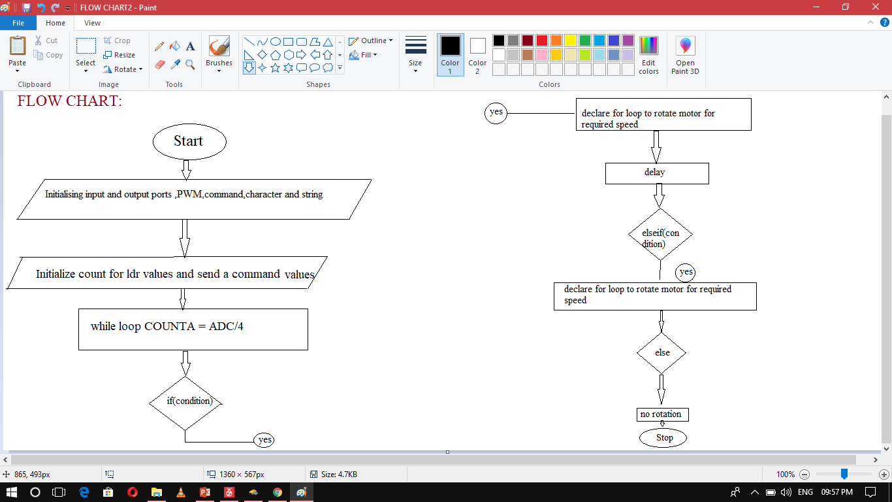

Slide 17
Algorithm:
Start the program.
Initialising the input and output ports , PWM port .
Initialize void command for reading command values , void character for characters , void string .
Initialize COUNTA , And do COUNTA = ADC/4 operation and consider the resultant values as LDR values and display it on 16*2 LCD .
Set an if condition , if it is true declare a for loop to rotate motor to an required speed , else if set some condition , if it is true declare a for loop to rotate motor for other required speed and set some delay for both.
If both are false , else no rotation of motor.
Stop the program.

Slide 18
Source code:
#include<avr/io.h>
#define F_CPU 1000000
#include<util/delay.h>
#include<stdlib.h>
#define enable 5
#define registerselection 7
void send_a_command(unsigned char command);
void send_a_character(unsigned char character);
void send_a_string(char*string_of_character);
void PWM_init()
{
TCCR0=(1<<WGM00)|(1<<WGM01)|(1<<COM01)|(1<<CS00);
DDRB|=(1<<PB3);
}
int main(void){
DDRC=0XFF;
DDRA=0X00;
DDRD=0XFF;
_delay_ms(50);
int duty;
PWM_init();
ADMUX|=(1<<REFS0)|(1<<REFS1);
ADCSRA|=(1<<ADEN)|(1<<ADATE)|(1<<ADPS0)|(1<<ADPS1)|(1<<ADPS2);
int16_t COUNTA=0;
char SHOWA[3];
send_a_command(0x01);
send_a_command(0x38);
send_a_command(0x0E);
ADCSRA|=(1<<ADSC);

Slide 19
while(1){
COUNTA=ADC/4;
if((COUNTA>=255) && (COUNTA<=399))
{
for( int duty=100;duty<255;duty++)
{
OCR0=duty;
_delay_ms(8);
}
}
else if((COUNTA>=400) && (COUNTA<=500))
{
for( int duty=0;duty<255;duty++)
{
OCR0=duty;
_delay_ms(8);
}
}
else
{
duty=0x00;
}
send_a_string("smart bridge");
send_a_command(0x80+0x40+0);
send_a_string("temp(c)=");
send_a_command(0x80+0x40+8);
itoa(COUNTA,SHOWA,10);
send_a_string(SHOWA);
send_a_string("");
send_a_command(0x80+0);
}
}

Slide 20
void send_a_command(unsigned char command)
{
PORTC=command;
PORTD&=~(1<<registerselection);
PORTD|=(1<<enable);
_delay_ms(50);
PORTD&=~(1<<enable);
PORTC=0;
}
void send_a_character(unsigned char character)
{
PORTC=character;
PORTD|=(1<<registerselection);
PORTD|=(1<<enable);
_delay_ms(50);
PORTD&=~(1<<enable);
PORTC=0;
}
void send_a_string(char*string_of_characters)
{
while(*string_of_characters>0)
{
send_a_character(*string_of_characters++);
}
}

Slide 21
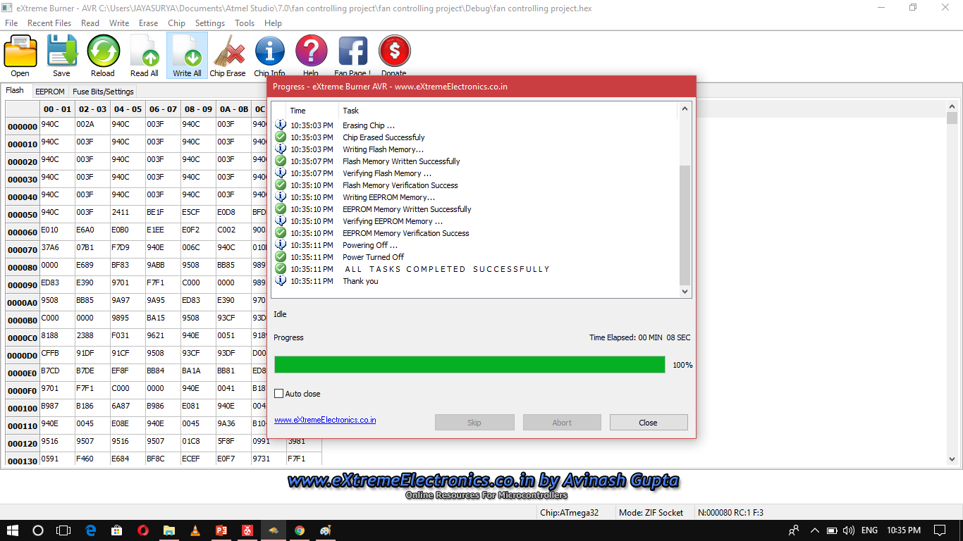

Slide 22
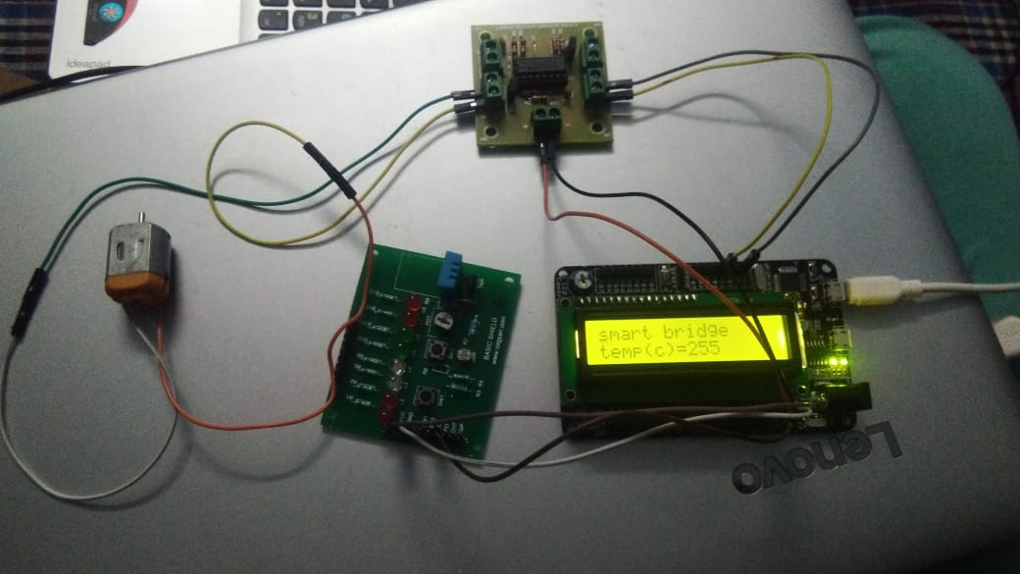
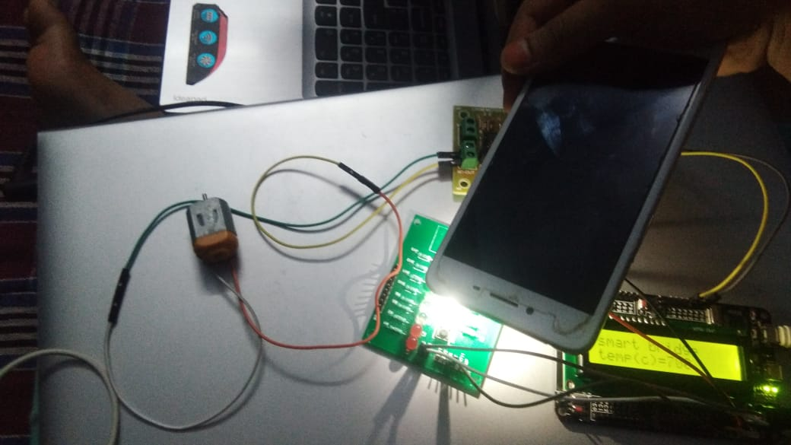
Working:
1.Connections are made as per the shown figure.
2.After flashing , the constant LDR value will be read on the 16*2 LCD display and motor will be rotated as per the loop declaration and to required speed.
3.When heat produced on the LDR the values will be increased and speed of motor also been increased as per the loop declaration.

